Slide 1
Rust probes
Final report
石尚锋

Slide 2
kprobe migration
Problem with previous kprobe crate hm1229/rkprobes: kprobes in rust (github.com)
Same trapframe crate in rCore is required
Kprobe trampoline pages need to be executable, but aren’t separated
Solution
Not making it a crate
A “kernel object” is hard to separate from kernel itself
Extract some OS dependent part instead

Slide 3
Results
Working migration on zCore and rCore-Tutorial
With cargo doc style comments
Separated code and migration Tutorial/Examples
livingshade/rCore-eBPF-enhancement (github.com)
portable kprobe实现 - My Docs (cubele.github.io)
Problems discovered during migration
A “kernel object” that need dynamic memory allocation ties closely with the kernel design(locks, memory management, lazy_static…)
Although we made a “portable” version, it’s better to overhaul it and unify it with your kernel design e.g. FrameTracker in Tutorial
Modularize inside an OS but not universally across OSs

Slide 4
Probing with symbols
Program need to know where to insert probe via a symbol table
Linux: @/proc/kallsyms
rCore: embedded in elf during compilation
Implement symbol table on zCore via file system
Also implemented backtrace and debuginfo parsing
Problem: symbol of async functions

Slide 5
Async probing
Async functions are split into parts
The function itself just returns the future
The closure does the work
These parts may be inlined (more likely than normal functions?)
Almost every async syscall in zCore is inlined in the huge closure <linux_syscall::Syscall>::syscall::{closure#0}
No explicit symbol in symbol table
Solution: find the address in DWARF debuginfo, or line2addr
Same with inlined functions but with complex symbols

Slide 6
Async tracing
Can we dynamically trace async functions via kprobes?
Static tracepoints: Announcing async-backtrace | Tokio - An asynchronous Rust runtime
Uses macro to insert static tracepoints while polling
Knows which futures are pending by logging during poll
Need to add macro to every child future for complete log
The best possible scenario: given a async function name, we can dynamically track its execution including its child futures

Slide 7
Async tracing
To achieve this via kprobes, we need to know the return value of all child poll functions without adding static tracepoints
Problems:
Polls generated by .await are hard to find (requires manual search)
Can’t capture return value of inlined polls
Still need to probe every child future to obtain the full trace

Slide 8
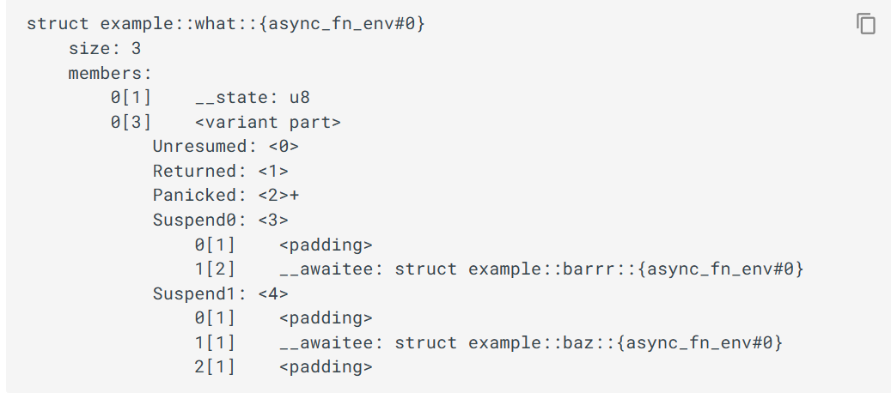
Async tracing
Another idea is to find the future dependency tree and trace the closures in it
Possible due to compiler support of debuginfo
https://github.com/rust-lang/rust/pull/95011

Slide 9
Async Probing
Problems:
Only works for compiler generated polls i.e. .await syntax, not for manually written polls e.g. join! select!
Can’t handle dynamic trait awaitees decided at runtime
Can’t know if the Future is finished

Slide 10
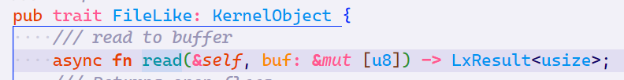
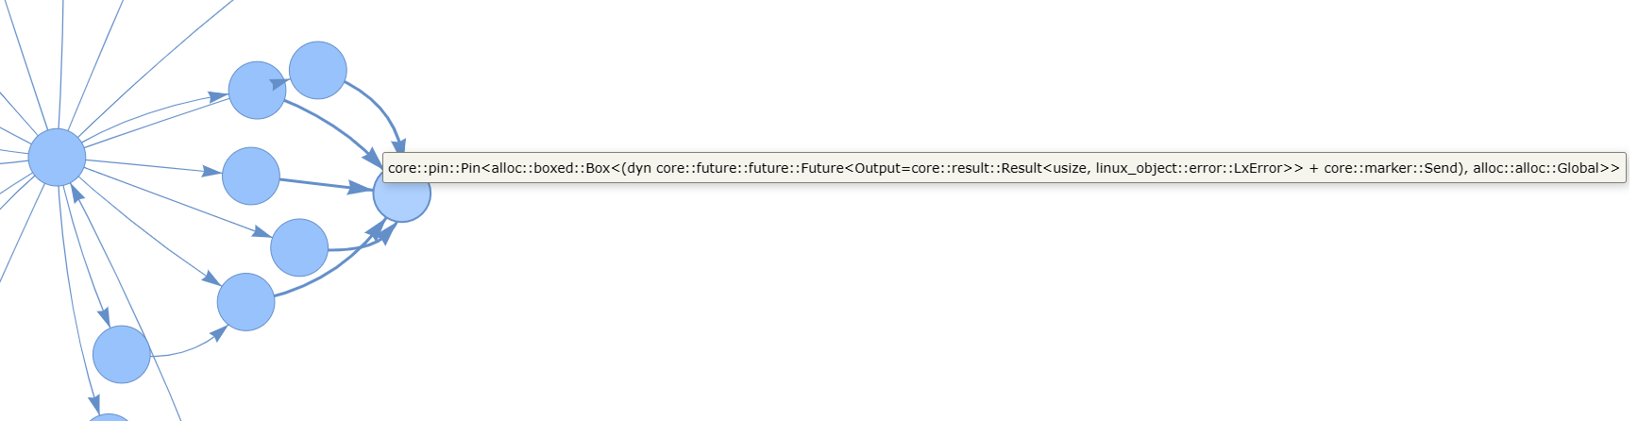
Example
zCore parsed using cubele/rust-async-tree-parser (github.com)
Awaited an async function in a trait

Slide 11
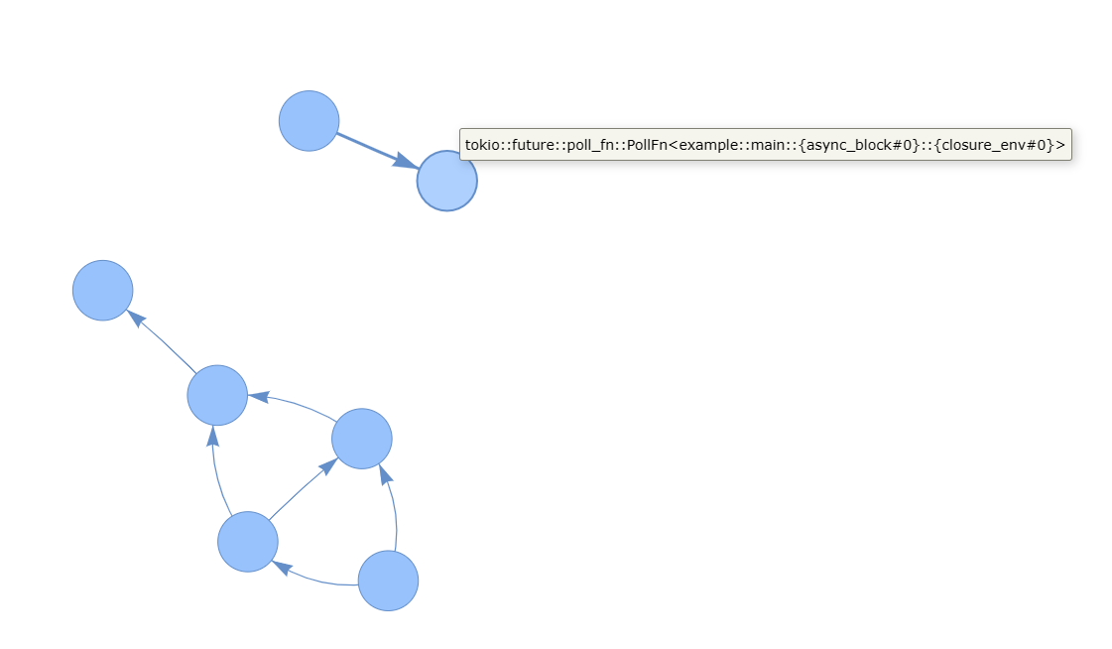
Example
A poll generated by join!

Slide 12
Async Probing
Can we find the struct on the heap?
Capturing the “Self” argument in poll could give us access to the __awaitee field and the __state field
Jprobe?
Need to know the structure of Pin<&mut Self>
Jprobe itself may be hard to implement in rust

Slide 13
Conclusion
What we can do now:
For manually written Futures with poll functions, the poll can be probed like a regular function, we can capture return value of poll with kretprobe.
For poll logic generated by .await, it will only yield in a leaf future implemented manually, we can probe the leaf Future poll instead.
The .await dependency graph can be parsed from debuginfo
For nonblocking logic in async functions, we can probe the closure.
Might need to obtain the address through debuginfo

Slide 14
Conclusion
Still need to find what to probe manually
Async rust is evolving rapidly
Multiple PRs merged during my research
Avoid `GenFuture` shim when compiling async constructs by Swatinem · Pull Request #104321 · rust-lang/rust (github.com)
Tracking issue for debuginfo
Debugger support for Rust async/await · Issue #73522 · rust-lang/rust (github.com)
debuginfo: identify awaitee (via special name or other solution) · Issue #95521 · rust-lang/rust (github.com)

Slide 15
Example
SleepFuture in zCore
eBPF using kprobes

Slide 16
Future work
Ideally, we can achieve:
Given an async function name, find all its leaf future dependencies, track its execution and know which leaf future it is stuck on
Needs compiler support
Jprobe seems like the best way to do it, but very difficult in this case

Slide 17
Q&A
Thanks for your attention!
My Docs (cubele.github.io)
livingshade/rCore-eBPF-enhancement (github.com)
Notes:
我的分享也至此结束，谢谢大家。

